Slide 1
Library Management: Developing a System Using Object- Oriented Programming Principles

Slide 2

Introduction to Library Management
In this presentation, we will explore
through the development of a system based on
principles. We will discuss the importance of effective library management and how OOP can enhance efﬁciency and user experience.

Slide 3
Project objectives
System Design and Architecture
Design a Modular System: Develop a modular architecture using OOP principles to ensure the system is scalable and maintainable. This includes defining clear class structures for different entities like books, members, and transactions.
Core Functionality Development
Book Management:
Add/Remove Books: Implement functionality to add new books to the library and remove outdated or lost books.
User Interface and Experience
Develop User-Friendly Interfaces: Create intuitive interfaces for both library staff and members, ensuring ease of use and accessibility.

Slide 4

involves overseeing various functions such as cataloging, circulation, and user services. Effective management ensures that resources are utilized efﬁciently and that users have access to the information they need. This slide will cover the key components of library management.

Slide 5





Implementing in library systems offers several advantages, including , , and . These beneﬁts lead to easier maintenance and the ability to expand functionalities as needed. This slide will delve into these beneﬁts in detail.

Slide 6





The four main principles of OOP are , , , and
. Each principle plays a crucial role in designing a robust library management system. This slide will provide an overview of these principles and their relevance.

Slide 7



Designing the Library System
When designing a library management system, it's important to identify the
needed. This includes user management, book cataloging, and
transaction processing. This slide will outline the steps involved in the design
phase.

Slide 8


Class Structure in OOP
In an OOP-based library system, classes represent the such as books, users, and transactions. Each class will encapsulate relevant data and methods.
This slide will illustrate how to structure these classes effectively.

Slide 9


User management is a critical component of library systems. By applying OOP, we can create a that handles registration, authentication, and role management. This slide will discuss the implementation details of user management.

Slide 10


Cataloging Books Efficiently
A well-structured is essential for cataloging. This class should include attributes like title, author, ISBN, and availability status. By using OOP, we can create methods for searching and updating book information. This slide will cover these aspects.

Slide 11

Transaction Processing
Transaction processing involves managing
the deﬁning a
of books. By
, we can
streamline this process, ensuring accurate tracking of due dates and ﬁnes. This slide will explain how to implement transaction processing.

Slide 12
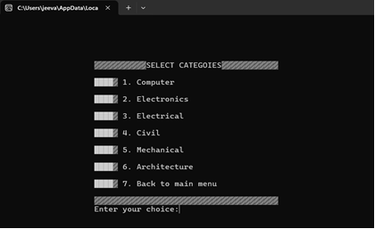
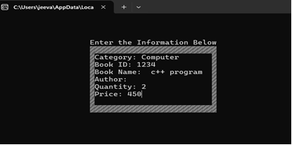
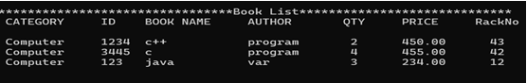
Pseudo code and output
START PROGRAM
DEFINE constants and data structures:
- categories array
- Date structure
- Book structure
FUNCTION gotoxy(x, y):
SET cursor position using Windows API
FUNCTION delay(milliseconds):
WAIT for the specified time
FUNCTION main():
CALL password function to authenticate user
RETURN 0
FUNCTION mainMenu():
CLEAR console
DISPLAY menu options
GET user input
SWITCH on user choice:
CASE '1': CALL addBooks()
CASE '2': CALL deleteBooks()
CASE '3': CALL searchBooks()
CASE '4': CALL issueBooks()
CASE '5': CALL viewBooks()
CASE '6': CALL editBooks()
CASE '7': CALL closeApplication()
DEFAULT: CALL mainMenu() for invalid input
// Additional function definitions for adding, deleting, etc.
END PROGRAM

Slide 13



Testing and Debugging
Testing is crucial to ensure the reliability of the library management system. By employing and , we can identify and ﬁx issues early in the development process. This slide will discuss effective testing strategies.

Slide 14





Future Enhancements
Once the initial system is in place, future enhancements can include
, and
. These features can signiﬁcantly improve user engagement and system performance. This slide will explore potential enhancements.
,

Slide 15



Conclusion
In conclusion,
through OOP principles leads to more efﬁcient and user-friendly systems. By focusing on design, implementation, and testing, libraries can better serve their communities and adapt to changing needs. Thank you for your attention!

Slide 16
Thank you!

